Slide 1
AD REVERSE ENGINEERING
DONE BY
VISWA BHARATHI S

Slide 2


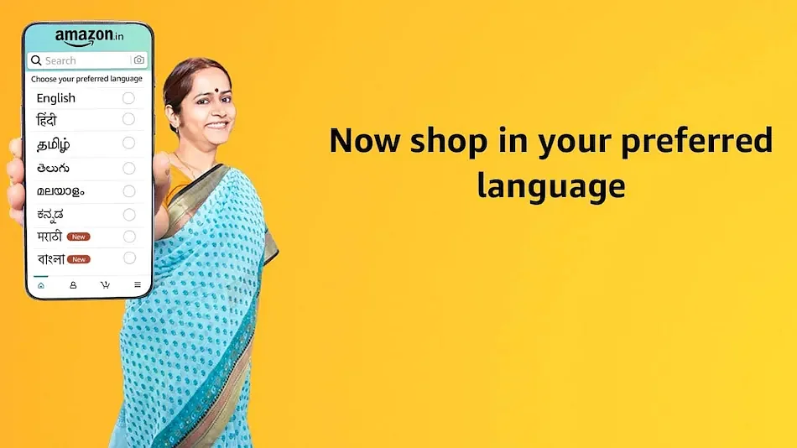
BRAND - AMAZON

Slide 3
Why do people choose online shopping over offline shopping ?
More choices on products
Open reviews and ratings
No mediators
Time saving
Payment modes
Door Step Delievery
Contact Less Shopping (Covid Protocols)

Slide 4
CASE 1 : LOCATION
Step 1 : Y=Purchase Count(D) ; X=Location(D)
Step 2 : Alpha=0.05
Step 3 : Two Proportion Test
Step 4 : H0->P(A)=P(B) ; H1->P(A)!=P(B)
Step 5 : Code
Step 6 : P Value

Slide 5
TABLE TO COMPARE DATA
 | ONLINE | OFFLINE
PURCHASE COUNT (REMOTE AREAS) | 3745 | 1564
PURCHASE COUNT (NON REMOTE AREAS) | 4954 | 6537
TOTAL PURCHASE | 8699 | 8101

Slide 7
CASE 1 - INTERPRETATION
P value is less than alpha
Therefore, location does affect the number of purchases.

Slide 8
CASE 2 : number of brands
Step 1 : Y=Purchase Count(D) ; X=No. of Brands(D)
Step 2 : Alpha=0.05
Step 3 : Chi Square Test
Step 4 : H0->P(A)=P(B) ; H1->P(A)!=P(B)
Step 5 : Code
Step 6 : P Value

Slide 9
table to compare data
 | SHOP_A | ONLINE
SONY | Y | Y
TOSHIBA | N | N
PANASONIC | N | Y
SAMSUNG | Y | Y
LG | N | Y
MICROSOFT | N | Y
APPLE | Y | Y
INTEL | N | N
IBM | N | N
FUJITSU | N | N
ACER | N | Y
DELL | Y | Y
ASUS | N | N
NIKON | N | Y
GOPRO | N | N
AMKETTE | N | N
BPL | N | N
CELKON | N | N
GODREJ | Y | Y
HCL | N | N
WHIRLPOOL | N | Y
VIDEOCON | N | N
XIOMI | N | N

Slide 10
CASE 2 - INTERPRETATION
P value is less than alpha
Therefore, number of brands does affect the number of purchases.

Slide 11
CASE 3 : language
Step 1 : Y=Purchase Count(D) ; X=Languages(D)
Step 2 : Alpha=0.05
Step 3 : Two Proportion Test
Step 4 : H0->P(A)=P(B) ; H1->P(A)!=P(B)
Step 5 : Code
Step 6 : P Value

Slide 12
TABLE TO COMPARE DATA
 | BEFORE | AFTER
TAMIL NADU | 6547 | 8734
KERALA | 6321 | 9384
TOTAL PURCHASE | 12,868 | 18,118

Slide 14
CASE 3 - INTERPRETATION
P value is less than alpha
Therefore, languages does affect the number of purchases.

Slide 15
THANK YOU

